Slide 1
Web和HTTP

Slide 2
Web / WWW
First some jargon
Web page consists of objects
Object can be HTML file, JPEG image, Java applet, audio file,…
Web page consists of base HTML-file which includes several referenced objects
Each object is addressable by a URL
Example URL:
www.someschool.edu/someDept/pic.gif
host name
path name

Slide 3
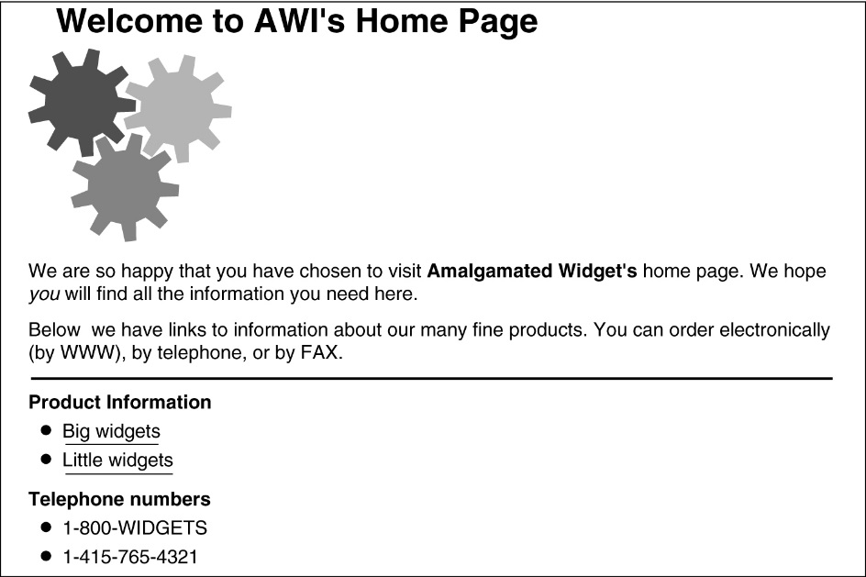
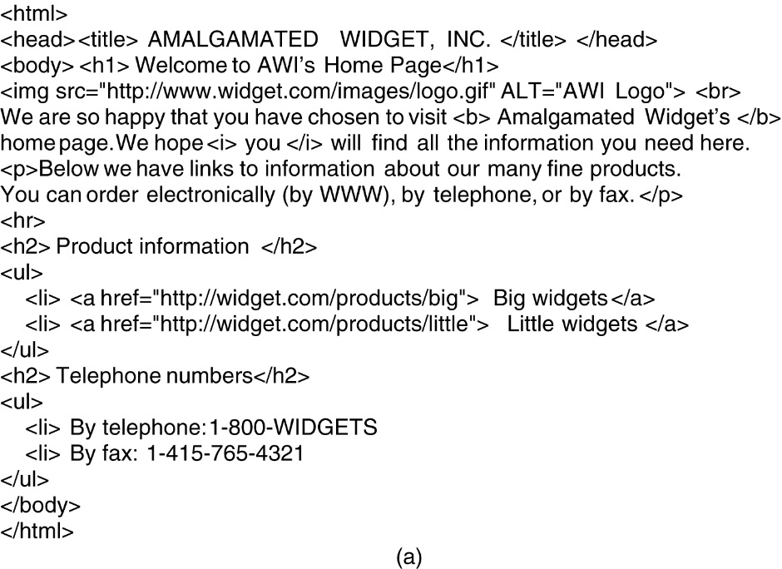
HTML – HyperText Markup Language
(a) The formatted page.
(b) The formatted page.

Slide 4
HTTP overview
HTTP: hypertext transfer protocol
Web’s application layer protocol
client/server model
client: browser that requests, receives, “displays” Web objects
server: Web server sends objects in response to requests
HTTP request
PC running
Explorer
HTTP response
HTTP request
Server
running
Apache Web
server
HTTP response
Mac running
Navigator

Slide 5
HTTP overview (continued)
Uses TCP:
client initiates TCP connection (creates socket) to server, port 80
server accepts TCP connection from client
HTTP messages (application-layer protocol messages) exchanged between browser (HTTP client) and Web server (HTTP server)
TCP connection closed
HTTP is “stateless”
server maintains no information about past client requests
aside
Protocols that maintain “state” are complex!
past history (state) must be maintained
if server/client crashes, their views of “state” may be inconsistent, must be reconciled

Slide 6
HTTP connections
Nonpersistent HTTP
At most one object is sent over a TCP connection.
Persistent HTTP
Multiple objects can be sent over single TCP connection between client and server.

Slide 7
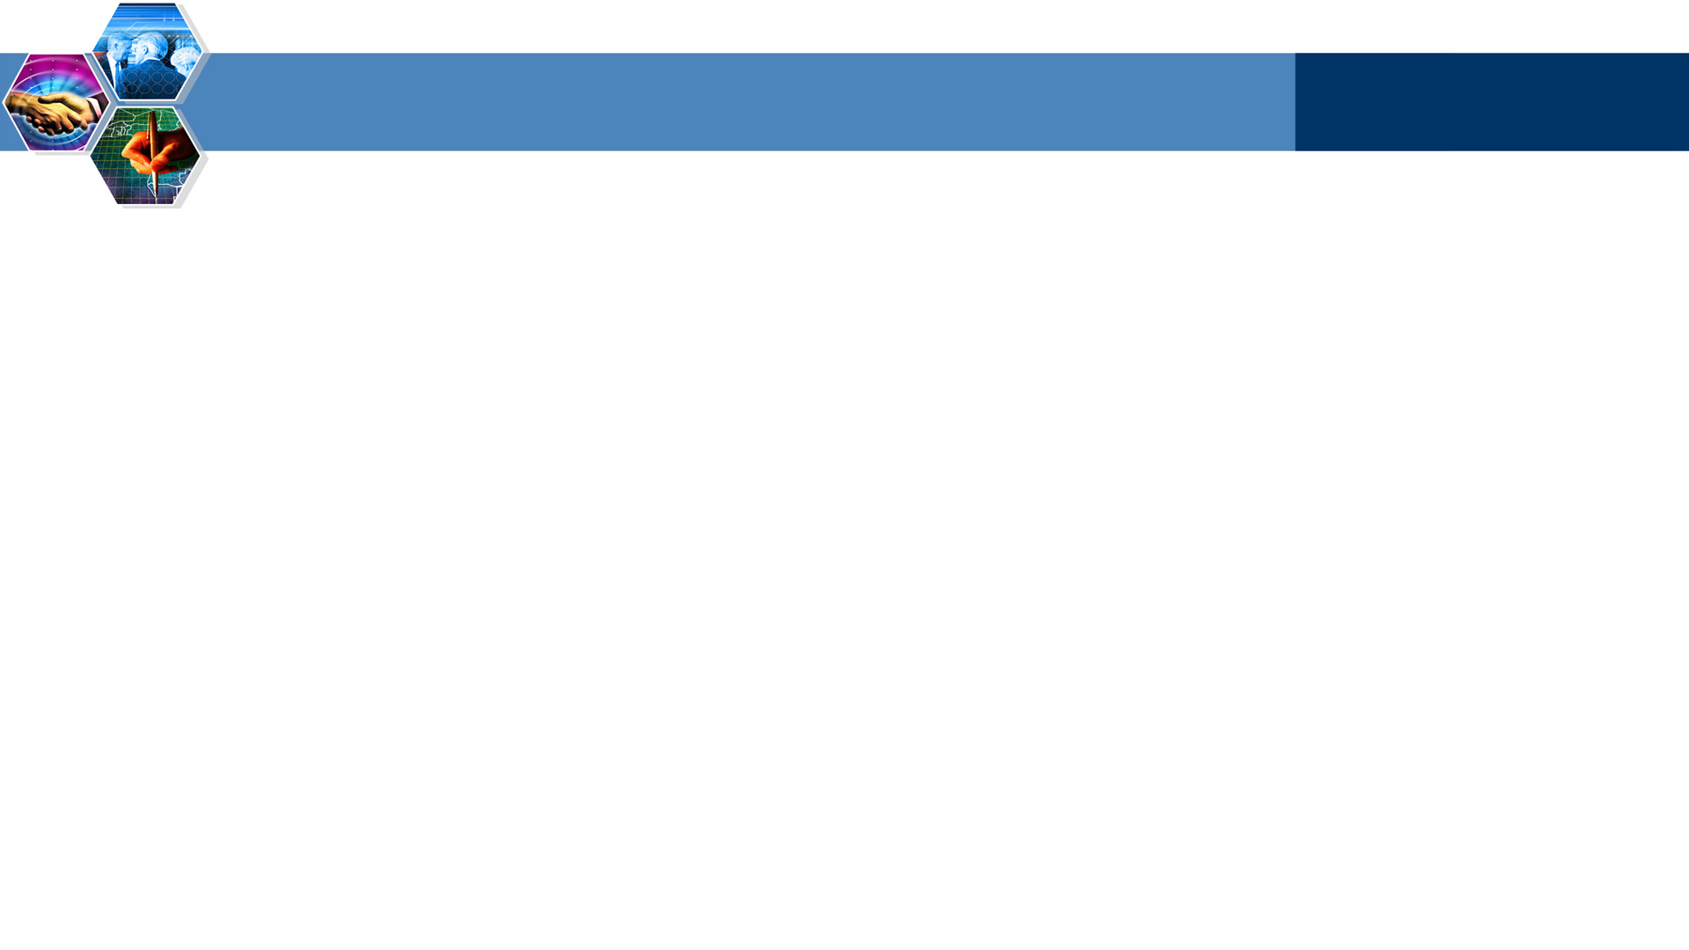
Nonpersistent HTTP
(contains text,
references to 10
jpeg images)
Suppose user enters URL www.someSchool.edu/someDepartment/home.index
1a. HTTP client initiates TCP connection to HTTP server (process) at www.someSchool.edu on port 80
1b. HTTP server at host www.someSchool.edu waiting for TCP connection at port 80. “accepts” connection, notifying client
2. HTTP client sends HTTP request message (containing URL) into TCP connection socket. Message indicates that client wants object someDepartment/home.index
time

Slide 8
Non-persistent HTTP (cont.)
3. HTTP server receives request message, forms response message containing requested object, and sends message into its socket
4. HTTP server closes TCP connection.
5. HTTP client receives response message containing html file, displays html. Parsing html file, finds 10 referenced jpeg objects
time
6. Steps 1-5 repeated for each of 10 jpeg objects

Slide 9
Non-Persistent HTTP: Response time
Definition of RTT: time for a small packet to travel from client to server and back.
Response time:
one RTT to initiate TCP connection
one RTT for HTTP request and first few bytes of HTTP response to return
file transmission time
total = 2RTT+transmit time
initiate TCP
connection
RTT
request
file
time to
transmit
file
RTT
file
received
time
time

Slide 10
Persistent HTTP
Persistent HTTP
server leaves connection open after sending response
subsequent HTTP messages between same client/server sent over open connection
client sends requests as soon as it encounters a referenced object
as little as one RTT for all the referenced objects
Nonpersistent HTTP issues:
requires 2 RTTs per object
OS overhead for each TCP connection
browsers often open parallel TCP connections to fetch referenced objects

Slide 11
HTTP request message
two types of HTTP messages: request, response
HTTP request message:
ASCII (human-readable format)
request line
(GET, POST, HEAD commands)
GET /somedir/page.html HTTP/1.1
Host: www.someschool.edu
User-agent: Mozilla/4.0
Connection: close
Accept-language:fr
(extra carriage return, line feed)
header
lines
Carriage return,line feed
indicates end of message

Slide 12
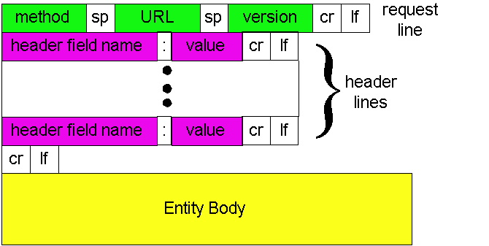
HTTP request message: general format

Slide 13
Method types
HTTP/1.0
GET
POST
HEAD
asks server to leave requested object out of response
HTTP/1.1
GET, POST, HEAD
PUT
uploads file in entity body to path specified in URL field
DELETE
deletes file specified in the URL field

Slide 14
HTTP response message
status line
(protocol
status code
status phrase)
HTTP/1.1 200 OK
Connection close
Date: Thu, 06 Aug 1998 12:00:15 GMT
Server: Apache/1.3.0 (Unix)
Last-Modified: Mon, 22 Jun 1998 …...
Content-Length: 6821
Content-Type: text/html
data data data data data ...
header
lines
data, e.g.,
requested
HTML file

Slide 15
User-server state: cookies
Many major Web sites use cookies
Four components:
1) cookie header line of HTTP response message
2) cookie header line in HTTP request message
3) cookie file kept on user’s host, managed by user’s browser
4) back-end database at Web site
Example:
Susan always access Internet always from PC
visits specific e-commerce site for first time
when initial HTTP requests arrives at site, site creates:
unique ID
entry in backend database for ID

Slide 16
Cookies: keeping “state” (cont.)
client
server
ebay 8734
usual http request msg
Amazon server
creates ID
1678 for user
cookie file
usual http response
Set-cookie: 1678
create
entry
ebay 8734
amazon 1678
usual http request msg
cookie: 1678
cookie-
specific
action
access
one week later:
usual http response msg
backend
database
access
ebay 8734
amazon 1678
usual http request msg
cookie: 1678
cookie-
spectific
action
usual http response msg

Slide 17
Cookies (continued)
aside
What cookies can bring:
authorization
shopping carts
recommendations
user session state (Web e-mail)
How to keep “state”:
protocol endpoints: maintain state at sender/receiver over multiple transactions
cookies: http messages carry state
Cookies and privacy:
cookies permit sites to learn a lot about you
you may supply name and e-mail to sites

Slide 18

Web caches (proxy server)
origin
server
Goal: satisfy client request without involving origin server
user sets browser: Web accesses via cache
browser sends all HTTP requests to cache
object in cache: cache returns object
else cache requests object from origin server, then returns object to client
Proxy
server
HTTP request
HTTP request
client
HTTP response
HTTP response
HTTP request
HTTP response
client
origin
server

Slide 19
More about Web caching
Why Web caching?
reduce response time for client request
reduce traffic on an institution’s access link.
Internet dense with caches: enables “poor” content providers to effectively deliver content (but so does P2P file sharing)
cache acts as both client and server
typically cache is installed by ISP (university, company, residential ISP)

Slide 20
Conditional GET
cache
server
Goal: don’t send object if cache has up-to-date cached version
cache: specify date of cached copy in HTTP request
If-modified-since: <date>
server: response contains no object if cached copy is up-to-date:
HTTP/1.0 304 Not Modified
HTTP request msg
If-modified-since: <date>
object
not
modified
HTTP response
HTTP/1.0
304 Not Modified
HTTP request msg
If-modified-since: <date>
object
modified
HTTP response
HTTP/1.0 200 OK
<data>

Slide 21

Summary
Web
Nonpersistent HTTP
Persistent HTTP
Cookie
Web cache

